Slide 1
Global Superstore Sales Analysis
By – Tejaswini Nannaware
M.sc(MATH)

Slide 2
Execution Summary
Dataset name is Global Superstore Dataset.
Data set is having 24 column and 51291 rows.
Learning Outcome : Creating chart, dashboards and story.
Identify KPI’s
Using objects – chart type, labels, size, shape and colors.
Filters and sorting.

Slide 3
Objective
To visualize the data for a online retail store.
Generate insights that would help business to drive the operation better.

Slide 4
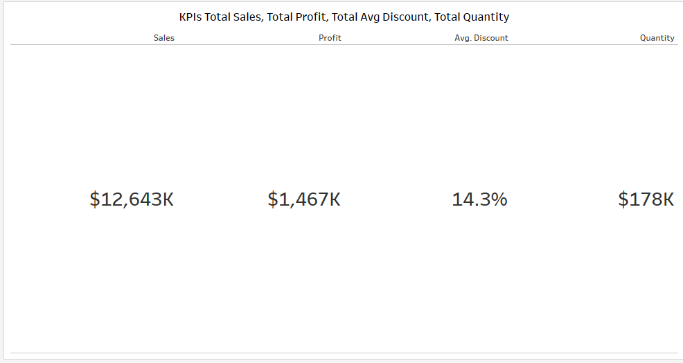
KPIs

Slide 5
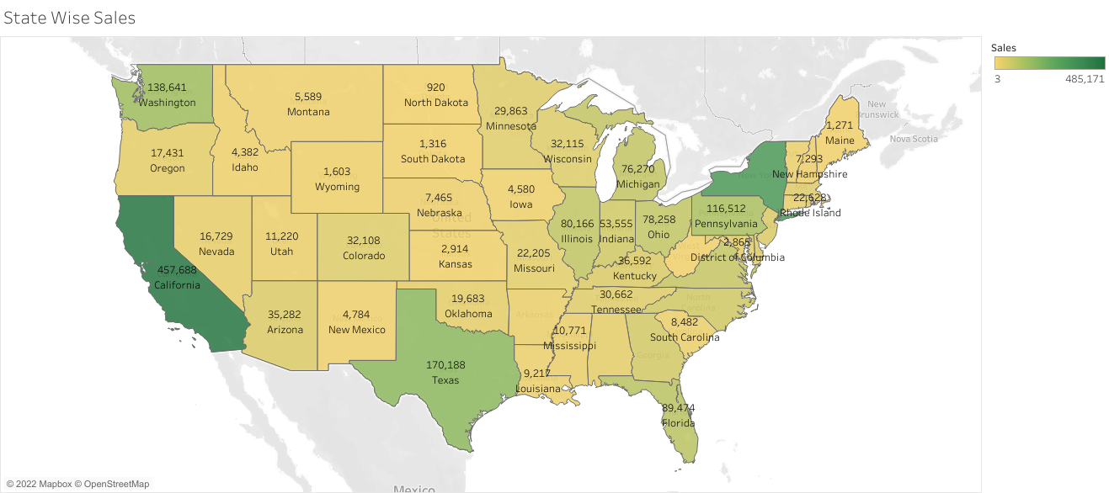
State Wise Sales
California is highest sales compare others state

Slide 6
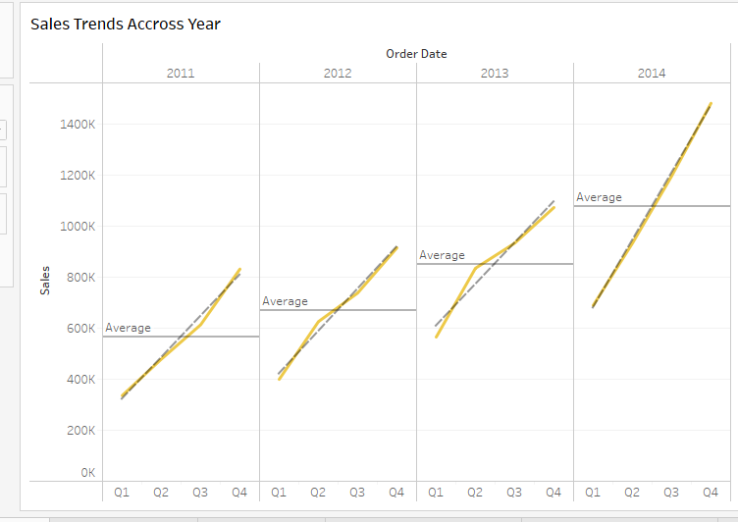
Sales Trends Across Year
Sales are increses and also average is increses

Slide 7
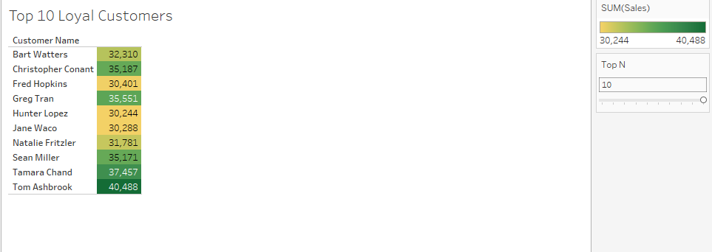
Top 10 Loyal Customers
These are top 10 loyal customers

Slide 8
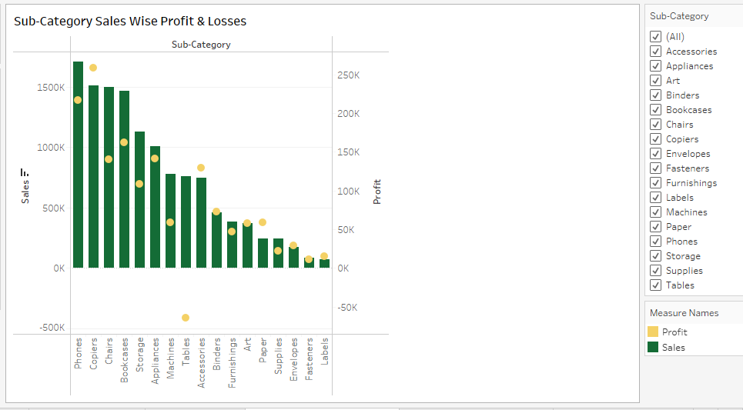
Sub-Category Sales Wise Profit & Losses
Phones are highest in sales and Labels are in lowest in sales And copiers are highest in profit and Tables are in loss

Slide 9
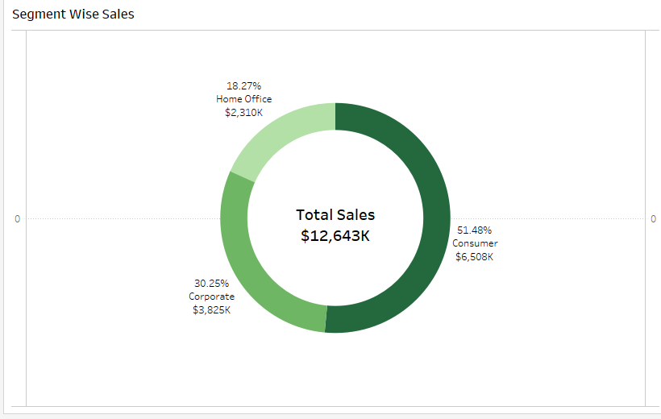
Segment Wise Sales
Most of the Sales done by Consumer Segment

Slide 10
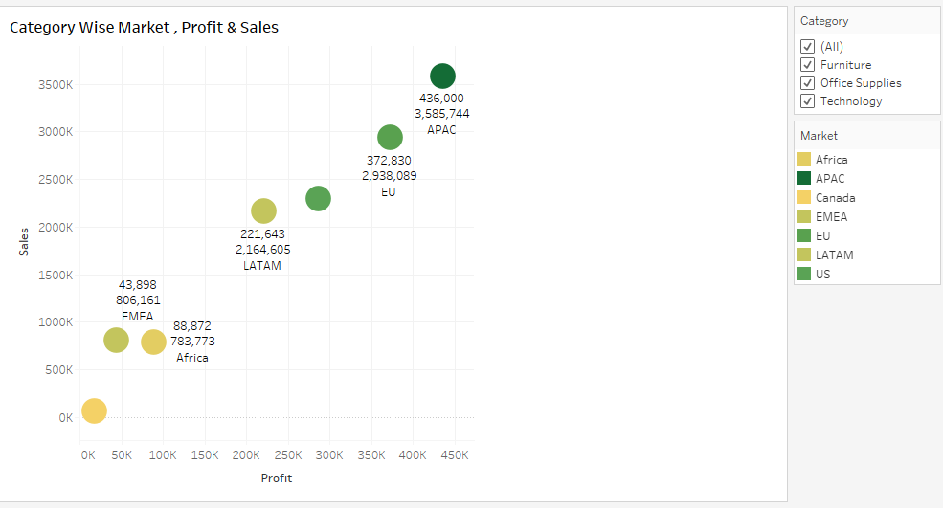
Category Wise Market , Profit & Sales
Market APAC is highest profits & sales

Slide 11
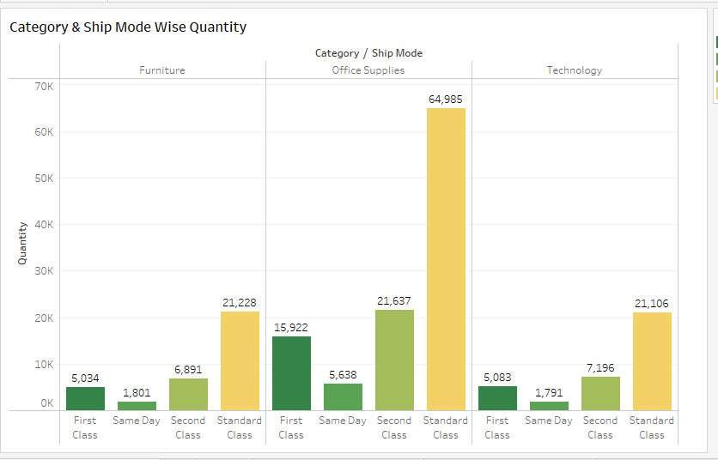
Category & Ship Mode Wise Quantity
Office Supplies Category and Standard Class Ship Mode are most of Quantity

Slide 12
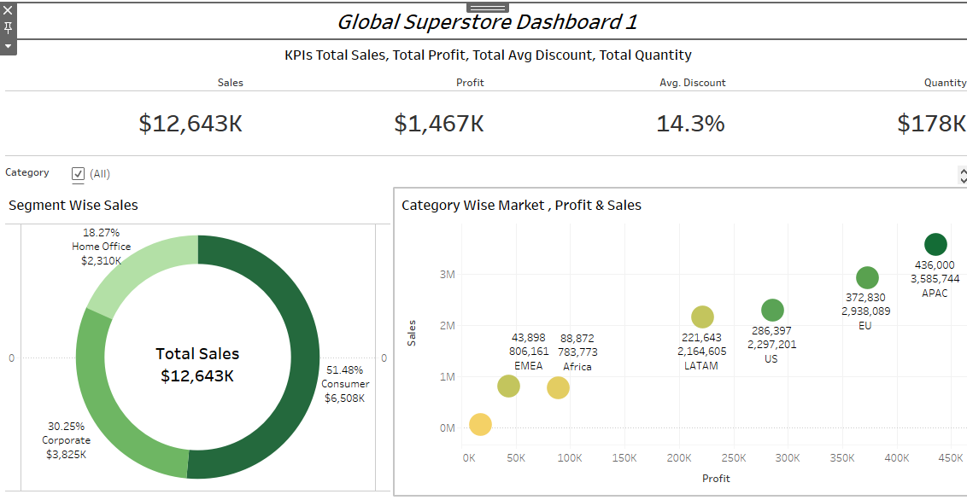
Global Superstore Dashboard 1

Slide 13
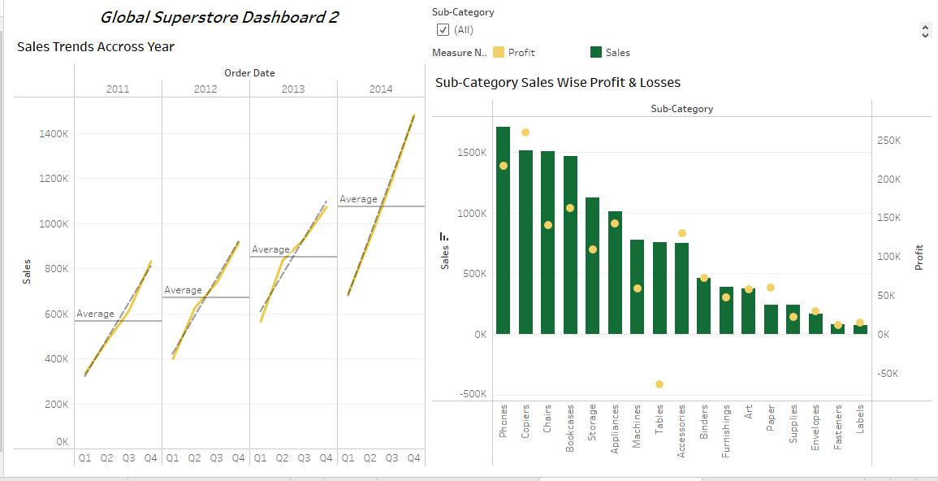
Global Superstore Dashboard 2

Slide 14
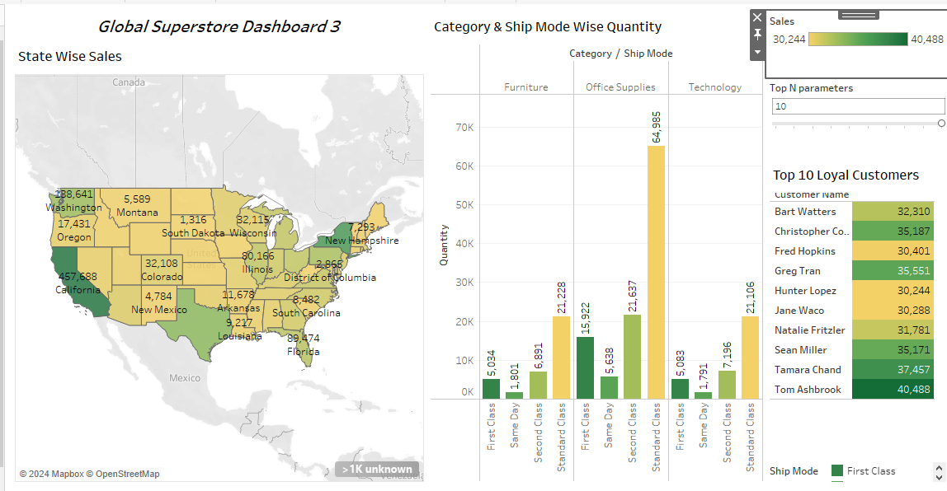
Global Superstore Dashboard 3

Slide 15
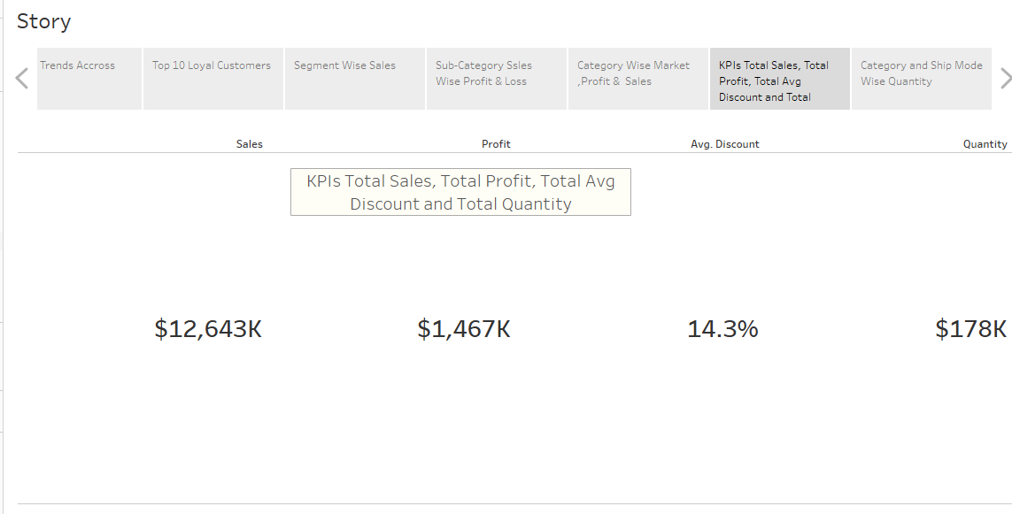
Story

Slide 16
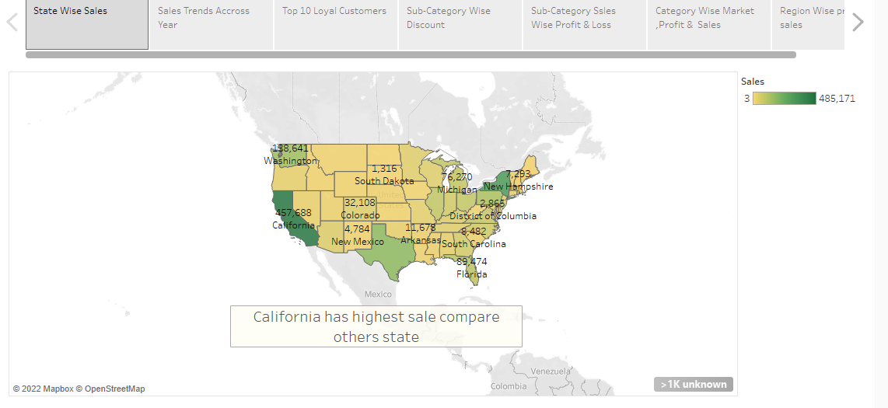
Story

Slide 17
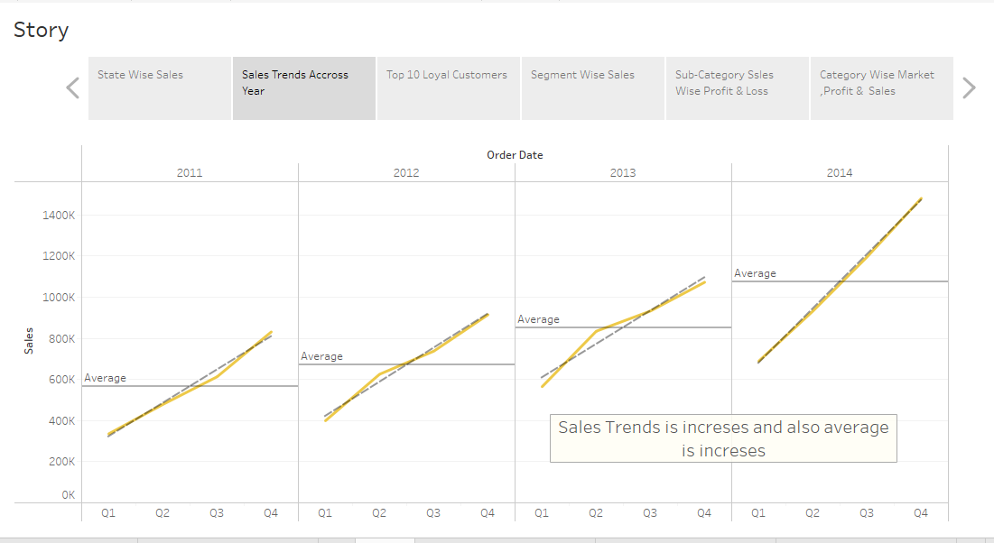
Story

Slide 18
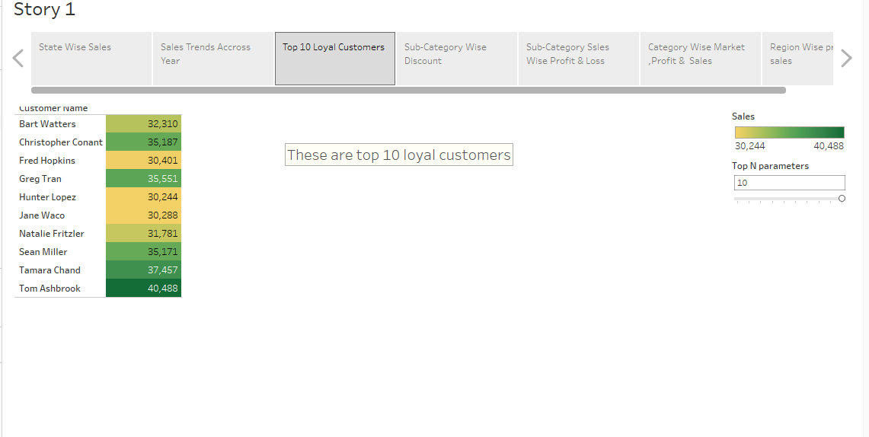
Story

Slide 19
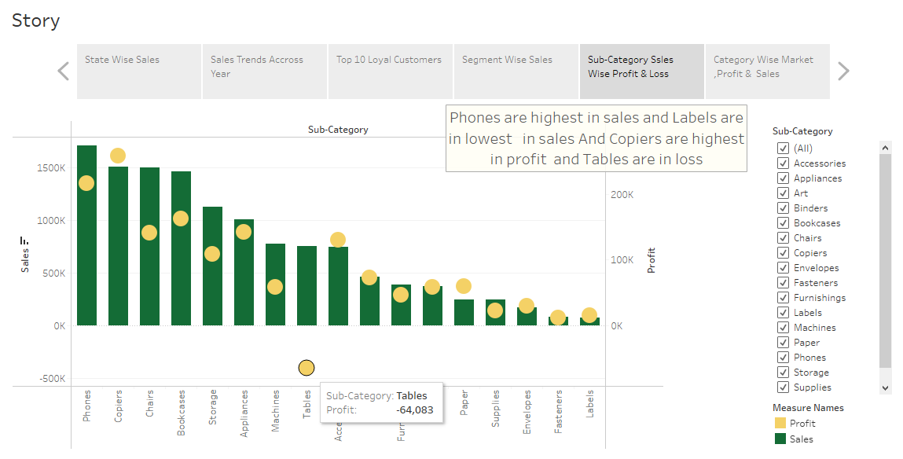
Story

Slide 20
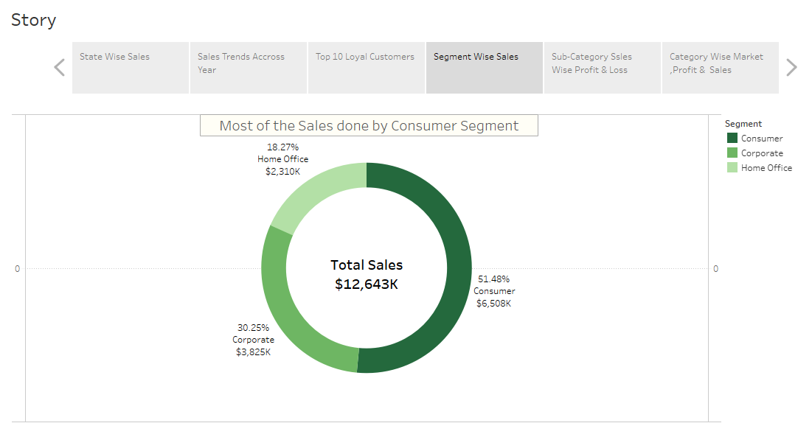
Story

Slide 21
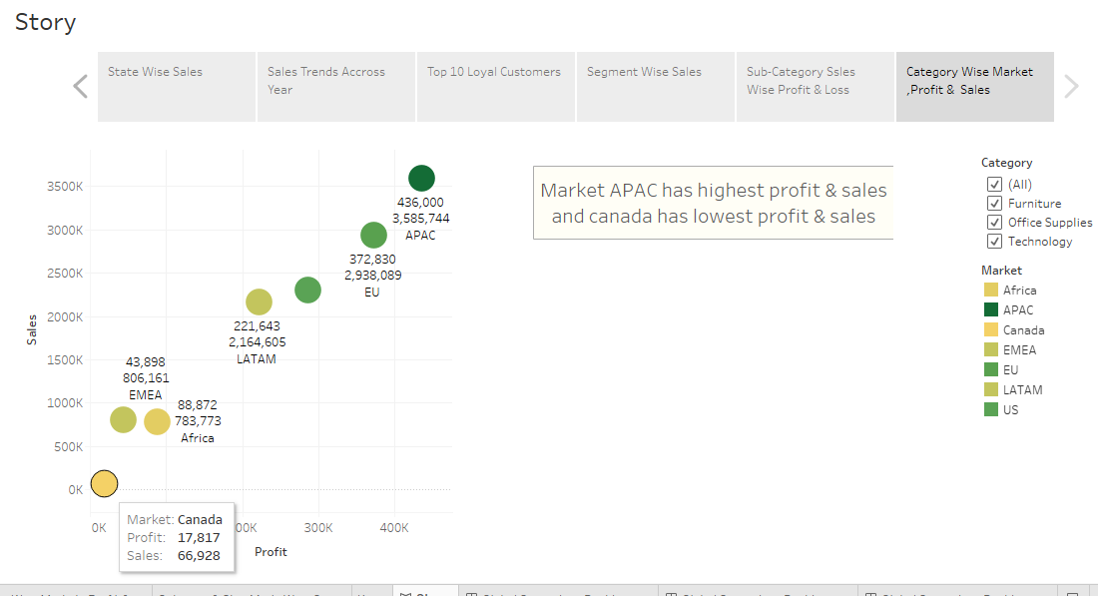
Story

Slide 22
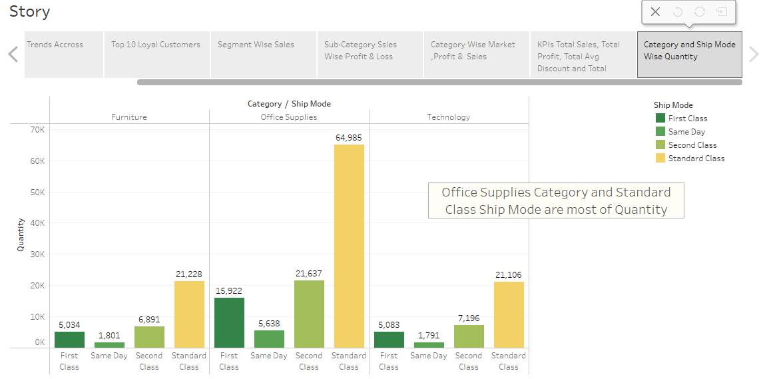
Story

Slide 23
Thank You

